Slide 1

EDA – EXPLORATORY DATA ANALYSIS ON HOTEL BOOKING
PRESENTED By:
VEDAXI GODAVALE​
CO-PRESENTER:
DIPTI PATEL​
GUIDED By:
ABHISHEK WAHVAL​

Slide 2
EDA – EXPLORATORY DATA ANALYSIS ON HOTEL BOOKING
PRESENTED By:
VEDAXI GODAVALE​
CO-PRESENTER:
DIPTI PATEL​
GUIDED By:
ABHISHEK WAHVAL​

Slide 3
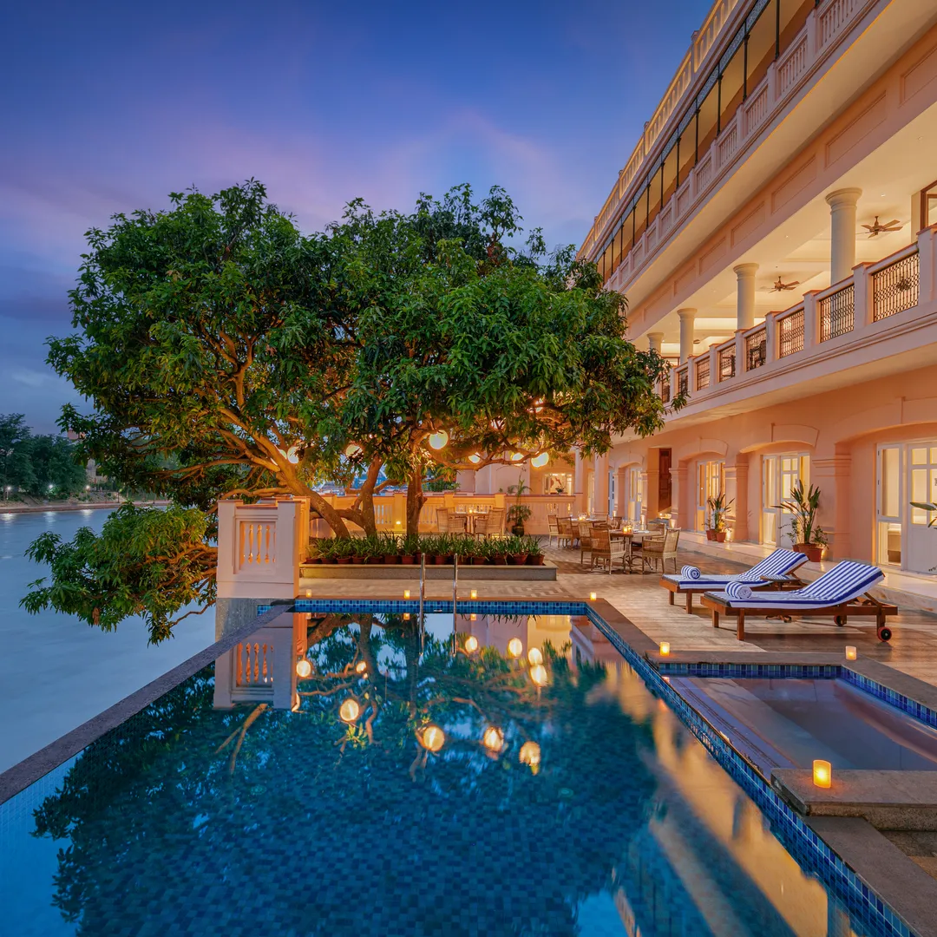
EDA – EXPLORATORY DATA ANALYSIS ON HOTEL BOOKING
This project involves analyzing a dataset provided by a hotel group spanning three years (2015-2017) for City Hotel and Resort Hotel.
The dataset includes details on revenue, booking information, guest demographics, stay duration, cancellations, and more.
The analysis aims to understand the business performance of both hotels individually and comparatively.
Initial steps include data cleaning to address null values and duplicates, followed by data wrangling.
The analysis will utilize charts to visually represent key insights, including country-wise booking patterns and the impact of agents and other channels on room bookings.
PRESENTED By:
VEDAXI GODAVALE​
CO-PRESENTER:
DIPTI PATEL​
GUIDED By:
ABHISHEK WAHVAL​

Slide 4

Business Objective
Analyze and visualize the data on bookings of City Hotel and Resort Hotel to gain insights on the different factors that affect the booking and ADR.
Objective of Project
The objective of this project is Explore and analyze the data to discover important factors that govern the bookings.

Slide 5
Data Variable Description
hotel - Type of hotel(Resort or City).
Is_cancelled - If there was booking cancel(0) or not(1).
lead time - The number of days between time books their room to arrive hotel.
arrival_date_year - Year of arrival date.
arrival_date_month - Month of arrival date.
arrival_date_week_number - Week no. of year for arrival date.
stays_in_weekend_nights - No. of weekend nights(Saturday or sunday) spend by guest at hotel.
stays_in_week_nights -No. of weeknight( Mon to Fri) spend by guest at hotel.
adults - No. of adults among guest.
children - No. of children among guest.
babies - No. of babies among guest.
meal - Type of meal booked by guest.
country - Country of guest.
market_segment - grouping into categories based on their booking patterns and travel habits.
distribution_channel - Name of booking distribution channel.
is_repeated_guest - If the booking was from repeated by guest(1) or not(0).
previous_cancelletions - No. of previous booking that were cancelled by the customer prior to the customer booking.
previous_booking_not_canceled - No. of previous booking that were not cancelled by the customer prior to the customer booking.
reserved_room_type - Code of room type reserved.
assigned_room_type - code of room type reserved.
booking_changes - No. of changes made to the booking.
deposit_type - Type of the deposit made by the guest.
agent - Id of the agent who made the booking.
company - Id of the company that made the booking.
days_in_waiting_list - No. of days the booking on the waiting list.
customer_type - Type of customer, assuming one of four categories.
adr - (Average Daily Rate) dividing the sum of lodgging transaction by the total number of staying night.
required_car_parking_spaces - No. of car parking spaces required by the customer.
total_of_special_request - No. of special request made by the customer.
reservation_request - Reservation status
reservation_request_date - Date of last reservation status updated.

Slide 6
Data cleaning
The given dataset is of Hotel Booking and we have to analyse and explore this dataset to discover important factors which affects the Hotel Booking. This dataset has 119390 rows and 32 columns.
The duplicate value count is 31994 rows. Removed duplicate values and errors.
There are 4 columns in dataset which is having missing values and those columns are company, agent, country and children.
There are separate columns called adults, children and babies that show the total number of people who are coming to visit, so instead of different columns will add these three in one called total no of people.
A column named total stay is created instead of different column of stay in weekend nights and stay in weekdays nights.
There are separate columns called arrival date year, arrival date month , arrival date day of the month that show the arrival date of the people who are coming to visit, so instead of different columns will add these three in one called arrival date.

Slide 7
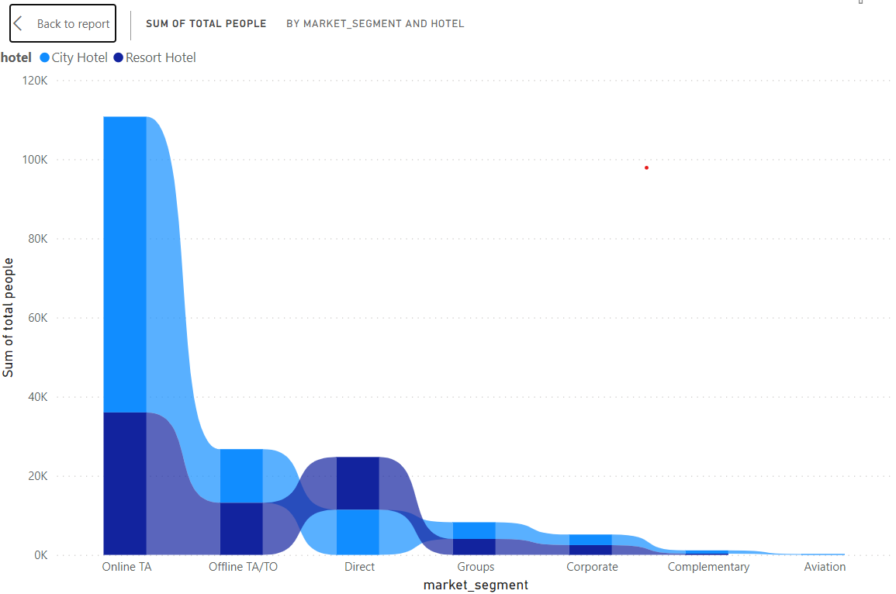
Which market segment is preferred by people ?
Why I used specific these chart?
I used ribbon chart to check hotel wise what market segment is and easy to visualization.
What are the insights found in this chart?
Based on above observation I found that people preferred Online TA in both city hotel as well as in resort hotel.
Will the gained insights would have positive business impact?
City hotel can find more services to attract more guests to increase more revenue
Resort hotel can find solution to attract customers and find the facilities provided by the city hotel to attract customers so this will be helping creating a positive business impact.

Slide 8
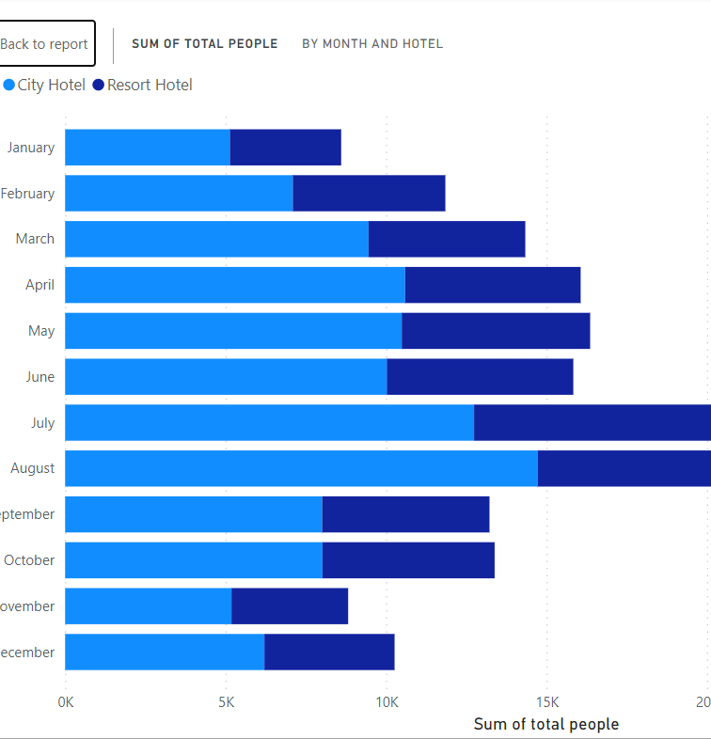
Which is the busiest month in both the hotels?
Why I used these specific chart?
Because it is very easy to understand with very first view.
What is the gained insights found in the chart?
Based on above observation I found that august month is busiest month for the both hotels.
Will the gained insights would have positive business impact?
Both hotels should also focus on the lowest months also to increase yearly and monthly revenue. Should provide best facilities and increase labor in the busiest month in both hotels, so customers doesn’t face discomfort and disatification.

Slide 9
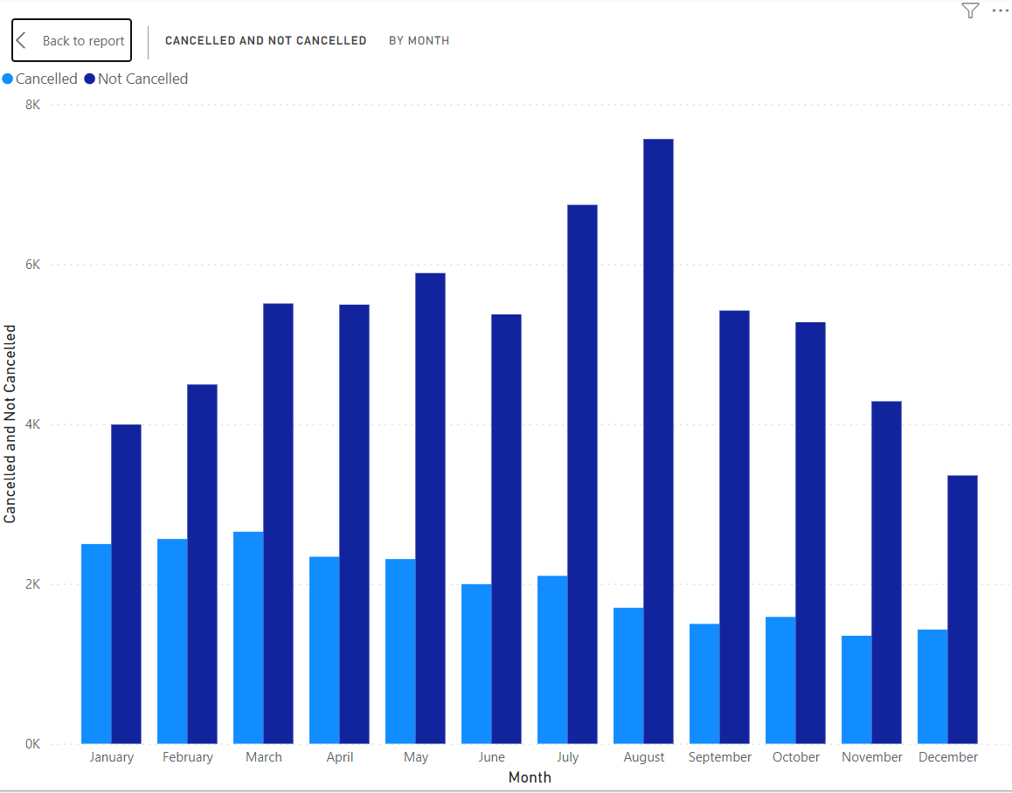
Cancelled and not cancelled bookings according to month
From this chart, we get to know that highest bookings are cancelled in April month.
August is the busied month and hotels should maintain their customers and with the highest not cancelled month.

Slide 10
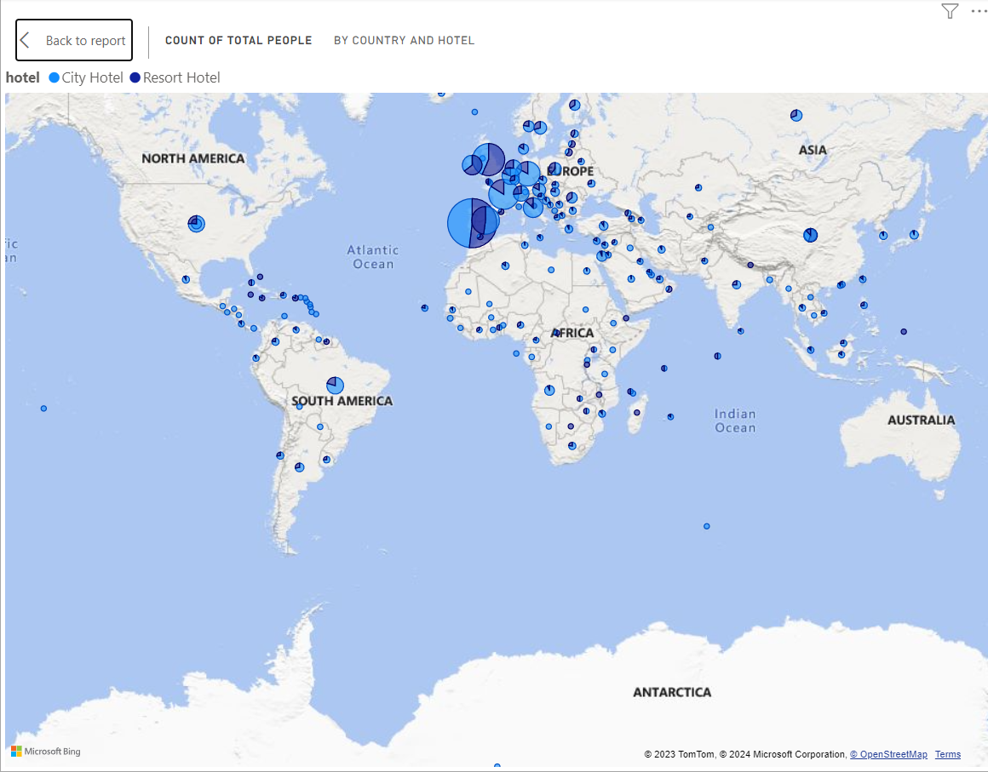
Total people by country and hotel

Slide 11
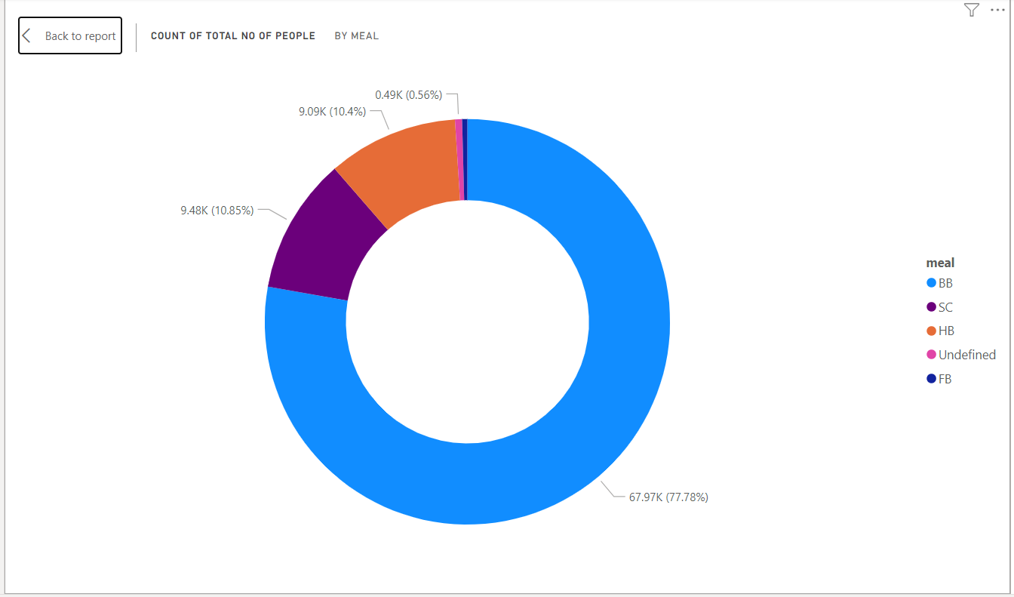
Meal preferred by People
From the observation, the most preferred meal by people stayed in the hotels is BB i.e. Breakfast in bed.
Because people come for travel and eat their meals outside while travelling and mostly prefer breakfast in bed and travel rest of the day.
Hotels should provide offers on the meals that customers order meals from hotel itself.

Slide 12
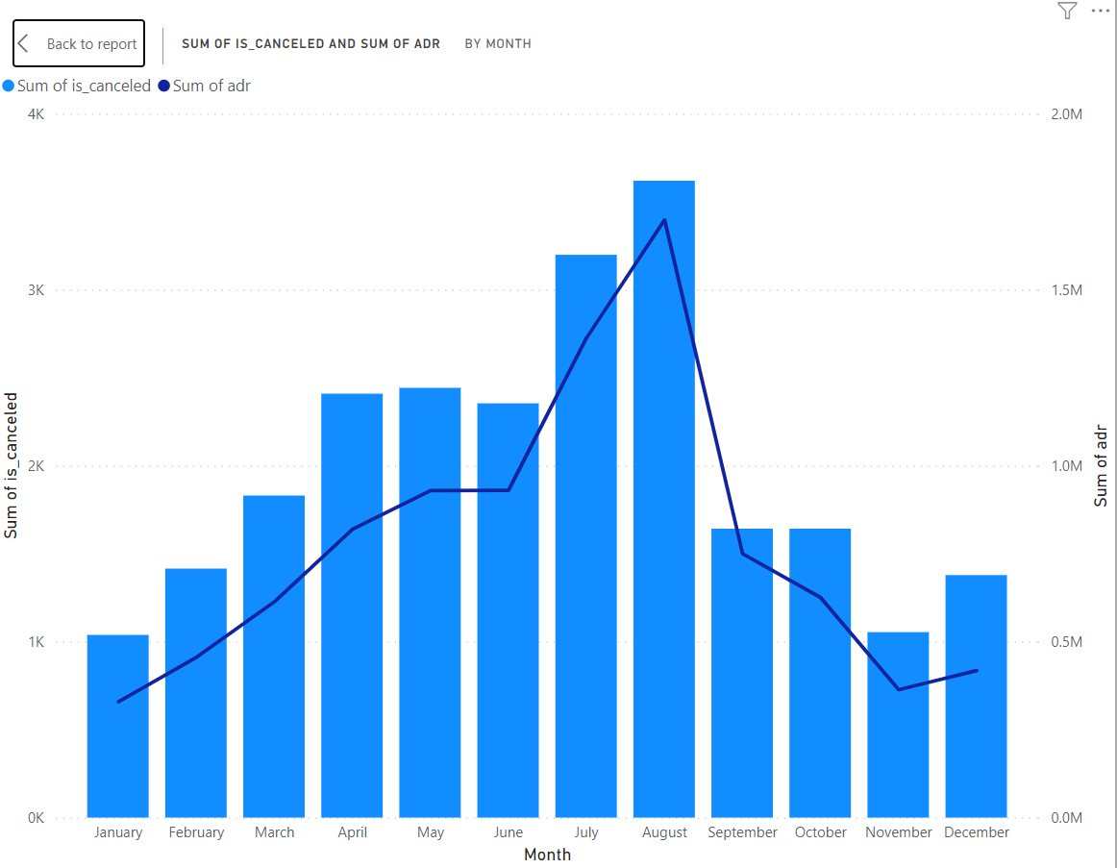
Effect of bookings cancellation on ADR
From the observation, the highest booking is cancelled in the month of August.
It has affected ADR directly.
Hotels should focus on the busiest month and the least busiest month also.
Because it affects the ADR in negative effect.
Hotels should hire employees and increase facilities in the busy months.

Slide 13
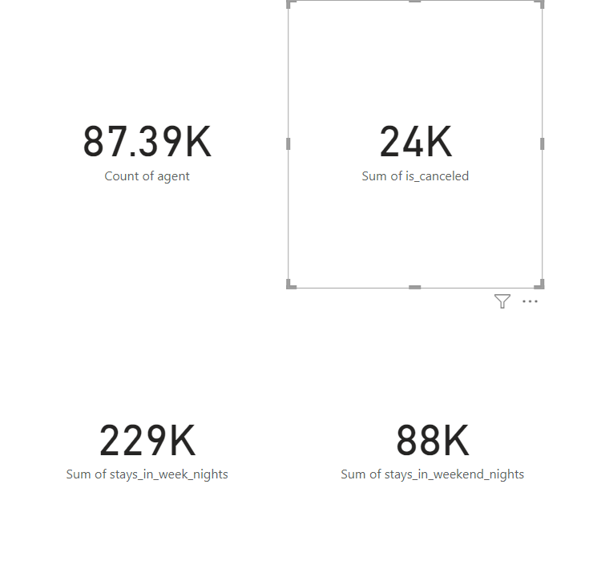
The bookings done by agent are 87.39 k with the total of both hotels.
Total 24 k bookings are cancelled including city and resort hotels.
Up-to till date, different customers stays in 229 k week nights and 88 k weekend nights in total.

Slide 14
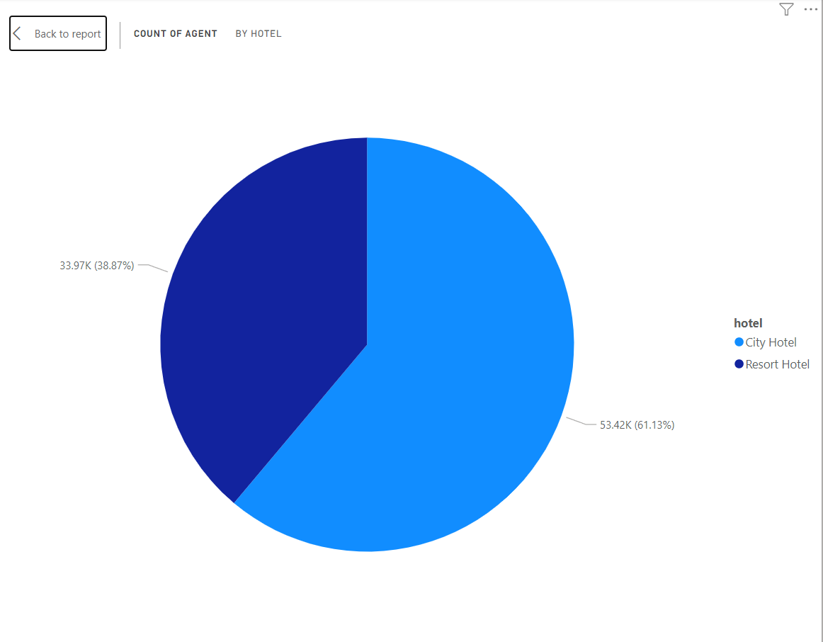
Bookings by Agent in hotels
From the observation , we observed that the highest bookings are done by agent in the city hotels i.e 61.13%.
The remaining 38.87% booking is done by agent in the resort hotels.
Both the hotels should reduced the means of bookings by agent because hotels has to pay commission to the agent and increase the expenses of the hotels.
Hotels should use attract the customers direct by building a powerful online website.

Slide 15
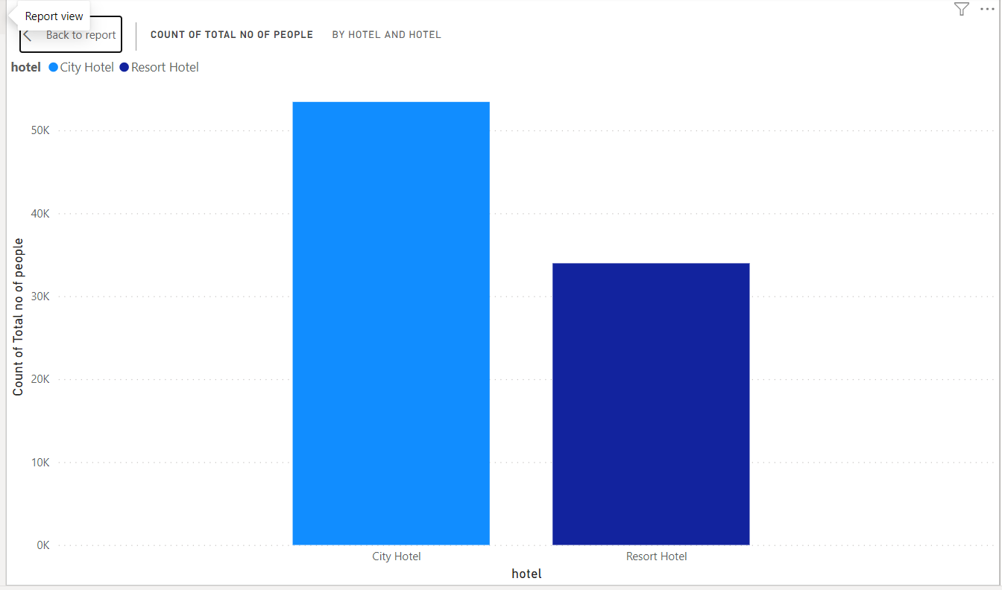
Most preferred hotel by people
From this chart, we observed that people mostly preferred to stay in city hotels.
60.84% of people from total people preferred city hotels.
Resort hotels should adapt facilities provided by city hotel to improve their preference among customers.

Slide 16
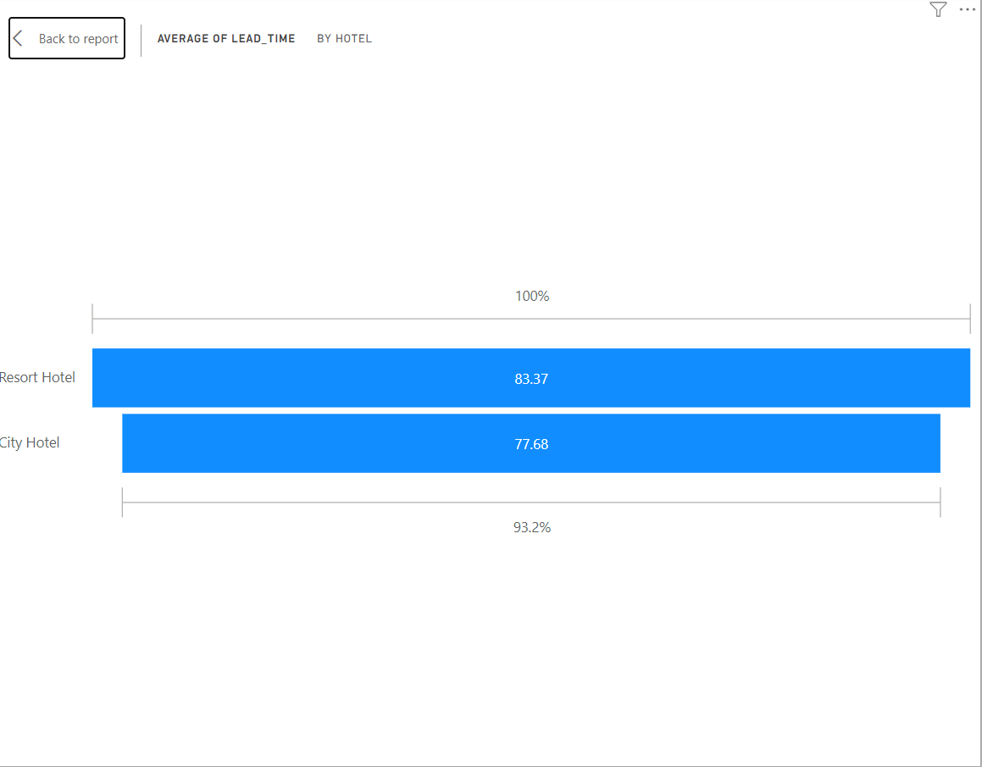
Average lead time by hotel

Slide 17
Solution to Business Objective
If any hotel improve their booking first they improve building of the hotel to attract customer.
Hotels should improve their basic facilities like proper management, transportations, etc.
Resort hotels should adapt the techniques used by city hotels to increase their revenue.
Both hotels should build strong impression on both offline and online platform.

Slide 18
Thank
You

